Slide 1
Objectives
In this session, you will learn to:
  Identify the hierarchy of objects in JavaScript
  Identify the various JavaScript objects
  Identify the various JavaScript language objects
Notes:
This session discusses the object model and language objects of JavaScript.
Start the session by sharing the objectives of the session with the students.

Slide 2
Introducing the JavaScript Object Model
JavaScript is an object-based language that uses custom and built-in objects to create interactive Web pages.
The JavaScript objects enable you to manipulate the components of a Web page.
Some of the objects used in JavaScript are:
  window object
  document object
  history object
  location object
  navigator object

Slide 3
Introducing the JavaScript Object Model (Contd.)
The window Object:
  The window object is one of the highest-level objects in the JavaScript object hierarchy.
  The window object represents the content area of the browser window that can be divided into multiple frames or
  sub-regions.

Slide 4
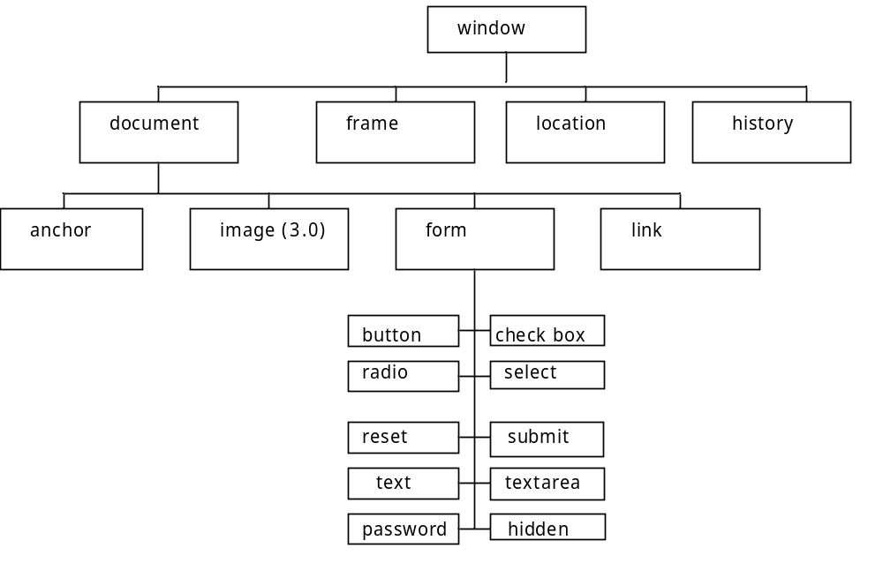
Introducing the JavaScript Object Model (Contd.)
The following figure displays the window object hierarchy.

Slide 5
Introducing the JavaScript Object Model (Contd.)
The following table lists some properties of the window object.
Properties | Description
defaultStatus | Is a string value containing the default status bar text. The status bar text is a string assigned by the user that is displayed when the mouse pointer is moved over the window. By default, the status bar text is an empty string.
frames[] | Is a collection of frames in a window. You can refer to a particular frame in a window by specifying its frame number within the [ ] of the frames [ ] property.
length | Is an integer value representing the number of frames in the parent window.
name | Is a string value containing the name of the window or the frame.
parent | Is a string value containing the name of the parent window.

Slide 6
Introducing the JavaScript Object Model (Contd.)
The following table lists some properties of the window object.
Properties | Description
self | Is a string value containing the name of the current window.
top | Is a string value containing the name of the uppermost window. The uppermost window is the current active window overlapping all open windows.
window | Is an alternative name for the self or name property.
status | Is a string value and is used to set the text on the status bar of the window.

Slide 7
Introducing the JavaScript Object Model (Contd.)
Some of the widely used methods of the window object are:
  open() method
  close() method
  confirm() method
Notes:
Like properties, methods are also a part of an object. You call a method using the syntax, objectName.methodName(). Any arguments required for the method are passed between the parentheses.
For example, the window object possesses a method named close(), which is specified to the browser window using the command, window.close().

Slide 8
Introducing the JavaScript Object Model (Contd.)
open() Method:
  Used to open a Web page in the current window or in a new browser window.
  Syntax:
    open(“URL”,”Window Name”,”Attributes”);
    Where:
    URL is the address of the Web page to be displayed.
    Window Name is the name of the window in which the Web page is to be displayed.
    Attributes is the list of properties that must be associated with the window in which the Web page is to be displayed.
Notes:
Like properties, methods are also a part of an object. You call a method using the syntax, objectName.methodName(). Any arguments required for the method are passed between the parentheses.
For example, the window object possesses a method named close(), which is specified to the browser window using the command, window.close().

Slide 9
Introducing the JavaScript Object Model (Contd.)
The following table lists the properties that can be specified in the Attributes argument of the open() method.
Properties | Description
toolbar | Creates the Standard toolbar with buttons such as Back and Forward.
location | Creates the location entry field displaying the current URL.
directories | Creates the standard directory buttons, such as What's New and What's Cool that provide related information. Directory buttons in a Web browser access Web pages that contain information on how to browse the World Wide Web.
status | Creates the status bar at the bottom of the browser window.
menubar | Creates the menu bar at the top of the window.
Notes:
Properties of an object can be accessed using the syntax, objectName.propertyName. Here, both the object name and property name are case sensitive. Explain the various properties of the window object.

Slide 10
Introducing the JavaScript Object Model (Contd.)
The following table lists the properties that can be specified in the Attributes argument of the open() method.
Properties | Description
scrollbars | Creates scroll bars, which can be used when the Web page grows beyond the size of the current window.
resizable | Enables the resizing of the window by the user.
width | Specifies the window width in pixels.
height | Specifies the window height in pixels.
top | Specifies the y coordinate of the location where the window should open on the screen.
left | Specifies the left x coordinate of the location where the window should open on the screen.
Notes:
Properties of an object can be accessed using the syntax, objectName.propertyName. Here, both the object name and property name are case sensitive. Explain the various properties of the window object.

Slide 11
Introducing the JavaScript Object Model (Contd.)
close() Method:
  Used to close the current window or a secondary window in the current window.
  Syntax to close the current window:
    close();
  Syntax to close the secondary window of the current window:
    <secondary_window_name>.close();
    Where:
    <secondary_window_name> is the name of the secondary window.
Notes:
Like properties, methods are also a part of an object. You call a method using the syntax, objectName.methodName(). Any arguments required for the method are passed between the parentheses.
For example, the window object possesses a method named close(), which is specified to the browser window using the command, window.close().

Slide 12
Introducing the JavaScript Object Model (Contd.)
confirm() Method:
  Used to display a confirmation message before the execution of certain activities performed in a Web browser window.
  Syntax:
    val=confirm(“Message to be displayed:);
Notes:
Like properties, methods are also a part of an object. You call a method using the syntax, objectName.methodName(). Any arguments required for the method are passed between the parentheses.
For example, the window object possesses a method named close(), which is specified to the browser window using the command, window.close().

Slide 13
Introducing the JavaScript Object Model (Contd.)
document Object:
  It provides the properties and methods to work with many aspects of the current document, including information about anchors, forms, links, title, current location and URL, and the current colors.
  It does not have any events associated with it.
Notes:
The document object provides access to the elements in an HTML page from within the script. This includes the properties of form, link and anchor . It also includes global document properties such as background and foreground colors.

Slide 14
Introducing the JavaScript Object Model (Contd.)
The following table lists the properties of the document object.
Properties | Description
alinkColor | Is a string value representing the color for active links.
anchors[] | Is an array object containing references to all the elements in an <A> tag.
bgColor | Is a string value representing the background color of the document.
cookie | Is a string value containing name=value pairs of data that will persist in the memory of the client computer until the Web browser is cleared, if no expiration date is present. The data will also persist in the memory until the expiration date is reached.
fgColor | Is a string value representing the text color of the document.
Notes:
Properties of an object can be accessed using the syntax, objectName.propertyName. Here, both the object name and property name are case sensitive. Explain the various properties of the window object.

Slide 15
Introducing the JavaScript Object Model (Contd.)
The following table lists the properties of the document object.
Properties | Description
linkColor | Is a string value representing the color of the unvisited links.
lastModified | Is a string value representing the date and time when the document was last modified.
links[] | Is an array object containing references of all elements in the <A> tag and the elements that use the <AREA> tag.
location | Is a string value representing the current URL.
referrer | Is a string value representing the URL of the document from which the current document was accessed.
title | Is a string value representing the text between the <TITLE> and </TITLE> tags.
vlinkColor | Is a string value representing the color of the visited links.
Notes:
Properties of an object can be accessed using the syntax, objectName.propertyName. Here, both the object name and property name are case sensitive. Explain the various properties of the window object.

Slide 16
Introducing the JavaScript Object Model (Contd.)
Some of the widely used methods of the document object are:
  write() Method: Enables the user to output the text on the Web browser window.
  writeln() Method: Enables the user to output the text on the Web browser window and also appends a new line character at the end of the output.
  clear(): Clears the document window.
  close(): Closes an output stream opened with the document.open() method.
  open(): Opens a output stream to collect the output to be displayed on the Web page from the write() or writeln() methods.

Slide 17
Introducing the JavaScript Object Model (Contd.)
history Object:
  It contains a list of all pages that have been visited in the browser window.
  It has the following three methods:
    back(): To move to the previous page.
    forward(): To move to the next page.
    go(x): To move back x pages.
Notes:
The history object contains an array of previously visited URLs by the visitor. For example, to simulate the browser's back button, you can use the history object as <a href="javascript:history.go(-1)">Go back</a>. Explain the various methods of the history object.

Slide 18
Introducing the JavaScript Object Model (Contd.)
location Object:
  Is used to enable navigation to different URLs through JavaScript.
  The most frequently used property of the location object is the HREF property.
  The HREF property specifies the hypertext reference for the current or desired URL.
Notes:
The location object contains a number of methods and properties that enables you to manipulate the current URL of a window. For example, to read the URL of the current document, you can access the href property of the location object of the current window as var currentURL=window.location.href.

Slide 19
Introducing the JavaScript Object Model (Contd.)
Some of the properties of the location object are:
  hash: Specifies the internal link anchor name.
  host: Specifies the hostname:port portion of the URL.
  href: Specifies the partial or full path of a file or a Web site.
  port: Specifies the port number.
Notes:
Explain the various properties of location object to e students.

Slide 20
Introducing the JavaScript Object Model (Contd.)
navigator Object:
  Is an independent object that has its own set of properties and methods.
  You can use the navigator object to determine the latest features supported by a particular Web browser, such as browser version, user platform, and plug-ins.
  It does not have any events associated with it.
Notes:
The Navigator object of JavaScript returns useful information about the visitor's browser and system.

Slide 21
Introducing the JavaScript Object Model (Contd.)
The following table lists the properties of the navigator object.
Property | Description
appName | Specifies the name of the Web browser.
appVersion | Specifies information about the Web browser version, browser platform, and the country for which the Web browser is released.
appCodeName | Specifies the internal code name of the Web browser. For example, the internal code name returned for both, Microsoft Internet Explorer and Netscape browsers, is Mozilla.
Language | Specifies an identifier that denotes the local language version of the program. For example, language identifiers such as en and de signify the English and German languages, respectively.
mimeTypes[] | Specifies the file format of the information that travels on the Web. text/html and image/gif are two examples of MIME types.
Notes:
Explain the various properties of navigator object to the students.

Slide 22
Introducing the JavaScript Object Model (Contd.)
The following table lists the properties of the navigator object.
Property | Description
userAgent | Sends the string containing information such as browser version, code name, and platform from the client to the server. The server uses this string to identify the client.
plugins[] | Specifies an array of plug-in objects. Shockwave is an example of a plug-in. However, not all browsers support this property.
platform | Specifies the operating system of the Web browser.
Notes:
Explain the various properties of navigator object to the students.

Slide 23
Introducing the JavaScript Object Model (Contd.)
The methods associated with the navigator object are:
  javaEnabled(): Returns a boolean value that specifies whether JavaScript is enabled or disabled in the Web browser.
  preference(): Returns the Web browser preferences set by the user, such as background color.
  taintEnabled(): Returns a boolean value that specifies whether the security feature of the current Web browser is enabled or disabled.
Notes:
Explain the various methods of navigator object to the students.

Slide 24
Demo: Using Objects
Problem Statement:
  Fun Seasons Corp. is a leading departmental store in Chicago. The store provides online shopping facility to its customers across the United States. Harrison, the Web site administrator of the departmental store, wants to update the interface of the Web site to make it more attractive. He wants to add a feature to the Web site so that each time a user loads the Web site, a pop-up window appears with the departmental store name and the message “Online Shopping...Feel the difference”. In addition, Harrison needs to use JavaScript objects to include the preceding features. Help Harrison update the Web site.
Notes:
Explain the various methods of navigator object to the students.

Slide 25
Demo: Using Objects (Contd.)
Solution:
  To solve the preceding problem, you need to perform the following tasks:
    Design the user interface.
    Write the script.
    Verify the solution.
Notes:
Explain the various methods of navigator object to the students.

Slide 26
Introducing JavaScript Language Objects
These objects are not related to the documents located in the current window and are known as language objects.
Language objects are widely used for data processing in JavaScript.
JavaScript supports the following built-in language objects:
  String object
  Array object
  Date object
  Math object
Notes:
In addition to document based object, JavaScript also supports a number of built-in objects.

Slide 27
Introducing JavaScript Language Objects (Contd.)
The String object is one of the highest-level language objects in the JavaScript object hierarchy.
The following are some of the String object methods:
  charCodeAt(): Returns integer character code from a character.
  Concat(): Returns a concatenated string.
  fromCharCode(): Returns the concatenated string value of code numbers supplied as parameters.
  lastIndexOf(search_String [,startIndex]): Returns the index value of the last occurrence of the string by starting the search backwards from the beginning of the index.
  replace(): Matches a specified regular expression with a string and replaces the match with a specified substring.
Notes:
Whenever you assign a string value to a variable or property, you create a string object. String literals are also string objects. For example, the statement stringvar = "Hello!" creates a string object called stringvar.
Explain the various methods of the string object to the students.

Slide 28
Introducing JavaScript Language Objects (Contd.)
  search(): Returns an index value of the character within string where the search_String begins.
  slice(): Slices a section of a specified string and returns a new string containing the sliced section.
  split(): Returns an array of delimited items.
  strike(): Surrounds the string with the HTML <STRIKE> tag.
  substring(): Returns the characters in a string as a substring between two specified indices.
  ToLowerCase(): Converts a string in lowercase.
  ToUpperCase(): Converts a string in uppercase.
Notes:
Explain the various methods of the string object to the students.

Slide 29
Introducing JavaScript Language Objects (Contd.)
Some of the widely used properties of the string object are:
  length property: The length property is used to determine the length of a string in JavaScript.
  prototype property: The prototype property is used to specify a particular property or method as a prototype.
Notes:
Explain the two most common properties of the string object to the students.

Slide 30
Introducing JavaScript Language Objects (Contd.)
Arrays are variables used to store a sequence of values.
Some methods associated with the Array object are:
  concat(): Returns an array object as a combination of two array objects.
  join(separator_string): Returns an array of string from an array that is separated by a specified string separator, such as comma.
  pop(): Returns the last element of the array.
  push(): Pushes a value to the end of an array.
  reverse(): Reverses the order of the elements in an array.
  shift(): Selects the first element of the array and removes it from the array.
  slice(): Returns a new array from the original array by replacing a portion of the original array with another array.
  unshift():Inserts a value in the beginning of an array.
Notes:
The array object is used to store a set of values in a single variable name. Explain the various methods associated with array object to the students.

Slide 31
Introducing JavaScript Language Objects (Contd.)
Some widely used properties of the Array object are:
  Array object length Property: The length property of an array object returns the number of elements in the array.
  Array object prototype Property: The prototype property of the array object enables you to assign additional properties and methods similar to the string objects.
Notes:
Explain the various properties associated with array object to the students.

Slide 32
Introducing JavaScript Language Objects (Contd.)
The Date object supports a number of methods to handle date and time. These include:
  get()
  set()
  parse() and UTC() methods
  to()
  getTime()
  getYear()
  getMonth()
  getDate()
  getDay()
  getHours()
  getMinutes()
  getSeconds()
Notes:
The date object is used to work with dates and times. Explain the various methods associated with the date object to the student.

Slide 33
Introducing JavaScript Language Objects (Contd.)
Using the Math language object that consists of properties and methods, you can perform arithmetic and trigonometric operations.
Some methods associated with Math object are:
  Math.abs(value)
  Math.acos(value)
  Math.asin(value)
  Math.atan(value)
  Math.atan2(value1, value2)
  Math.ceil(value)
  Math.cos(value)
  Math.exp(value)
Notes:
The math object allows you to perform common math related tasks. Explain the various methods associated with the math object to the students.

Slide 34
Introducing JavaScript Language Objects (Contd.)
The following table lists the properties of the Math object and their constant values.
Property | Description | Value
Math.E | Euler’s constant | 2.718281828459045
Math.LN2 | Natural logarithm of 2 | 0.6931471805599453
Math.LN10 | Natural logarithm of 10 | 2.302585092994046
Math.LOG2E | Base 2 logarithm of Euler’s constant | 1.4426950408889634
Math.LOG10E | Base 10 logarithm for complex mathematical calculations | 0.4342944819032518
Math.PI | The PI constant | 3.141592653589793
Math.SQRT1/2 | The square root of 0.5 | 0.7071067811865476
Math.SQRT2 | The square root of 2 | 1.4142135623730951
Notes:
Explain the various properties associated with the math object to the students.

Slide 35
Demo: Using JavaScript Language Objects
Problem Statement:
  RoundTheClock, Inc. is an event management company based in North America. The company currently has a static Web site displaying generic information about the company. The company plans to organize a Rhythm and Blues concert on the event of New Year’s Eve. The senior management of the company wants to modify its Web site so that each time the Web site is loaded, the home page displays the current day, date, month, and year in the upper-left corner. Also, the home page should provide information about the number of days left for New Year ’s Eve. The visitors should be able book tickets for the concert through the Web site. David Simmons, a Web designer at RoundTheClock, Inc., has been assigned this task. Help David achieve the desired outcome.
Notes:
Explain the various methods of navigator object to the students.

Slide 36
Demo: Using JavaScript Language Objects (Contd.)
Solution:
  To solve the preceding problem, you need to perform the following tasks:
    Create the user interface.
    Write the script.
    Verify the solution.
Notes:
Explain the various methods of navigator object to the students.

Slide 37
Summary
In this session, you learned that:
  JavaScript has a hierarchical object model that describes the various objects and their relationships.
  The window object has various methods and properties that can be used to add different functionality to the window.
  The document object provides the properties and methods to work with the current document.
  The history object contains a list of all pages that have been visited in the browser window.
  The location object enables navigation to different URLs in a script.
  The navigator object allows you to determine the latest features supported by a particular browser such as browser version, user platform, and plug-ins.
Notes:
Read out the summary to the students.

Slide 38
Summary (Contd.)
  JavaScript provides built-in objects called language objects to perform data processing.
  Language objects include:
    String Object
    Array Object
    Date Object
    Math Object
  You can create the string object in JavaScript by assigning a string value to a variable or a property.
  Some of the widely used properties of the string object are:
    length property
    prototype property
  Arrays are variables used to store a sequence of values.
  To create an array, a new array object is assigned to the variable.
Notes:
Read out the summary to the students.

Slide 39
Summary (Contd.)
  The JavaScript Date object allows you to extract parts of date and time.
  The JavaScript Math object allows you to perform arithmetic and trigonometric operations.
Notes:
Read out the summary to the students.

